Slide 1
Computer-Based Testing Scoring Constructed Responses on ScorePoint

Slide 2
CBT Scoring
More than 145,000 students took the Grades 3-8 ELA and Math tests on computer in 2018.
All student Constructed Responses (CR) entered on computer were scored on computer via the ScorePoint platform.
More than 40 scoring consortia were established locally for CBT Scoring.
Five scoring vendors also participate in CBT Scoring on the ScorePoint platform.

Slide 3
CBT Scoring Models
Computer-entered constructed responses must be scored by educators from a minimum of three schools collaborating under the direction of a Lead Scoring Entity.
The following scoring models are permitted for CBT scoring using ScorePoint®:
Regional Scoring | (Three or More) Schools from Two Districts
Private Contractor (Third-Party Vendor) | Three or More Schools within a District

Slide 4
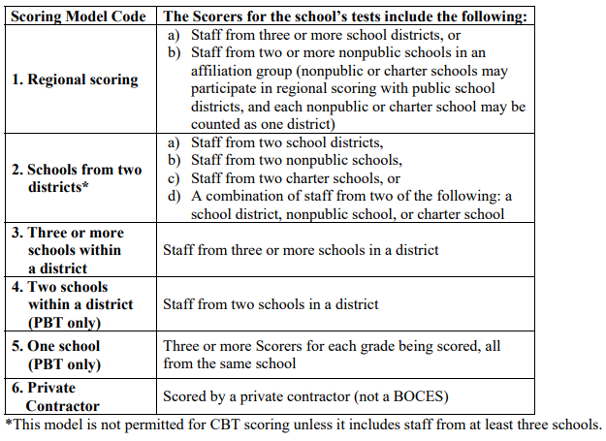
CBT Scoring Models
From page 20, Scoring Leader’s Handbook, 2017
The One-School Scoring Model is not permitted for CBT Scoring; it is a PBT scoring model only.

Slide 5
Lead Scoring Entity
Lead Scoring Entity
Name and BEDS Code of the school, district, BOCES, or scoring vendor that will be responsible for conducting scoring activities with educators from a minimum of three schools.
A school will indicate their Lead Scoring Entity when ordering CBT.
A school can have a different Lead Scoring Entity for ELA and Math.
A school cannot have a different Lead Scoring Entity within a subject or content area. All grade levels within a content area, such as Math, must be scored by the same Lead Scoring Entity.
Notes:
Diagram: scoring at a hotel = use the scoring director’s home org

Slide 6
Lead Scoring Entity
NYSED will reach out to the CEO of the Lead Scoring Entity to obtain contact information for the Scoring Director.
Contact information for the scoring director will be added to the ordering system.
For those schools that ordered CBT last year, their Lead Scoring Entity will be pre-populated in the ordering system.

Slide 7
ScorePoint, ELA Response

Slide 8
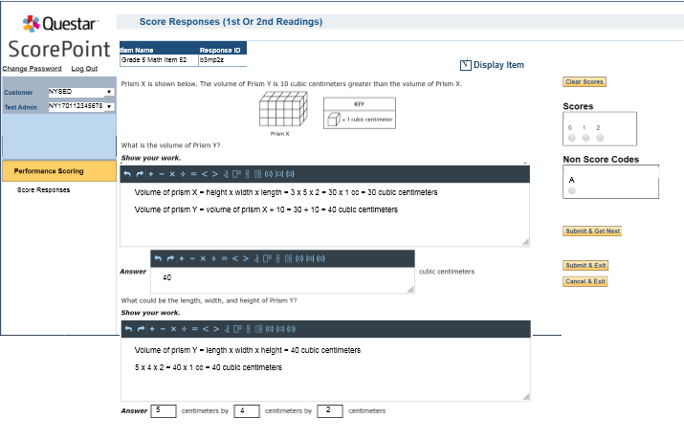
ScorePoint, Math Response
Example of Scoring a Response Entered on Computer

Slide 9
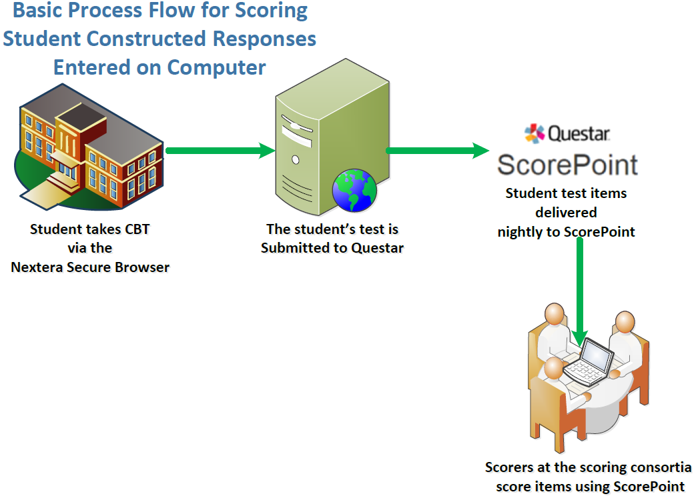
CBT Scoring Item Flow

Slide 10
CBT & PBT Scoring
How does CBT scoring differ from PBT scoring?
Scoring Area | Major Difference
Scoring Models | Single School and Two School Scoring Models are not allowed for CBT due to electronic item delivery to scorers.
Scoring | There are no paper booklets—all scorers will log into Questar’s online scoring platform, ScorePoint, to score electronically.
Items | CBT Scorers score individual CR items one student response at a time instead of one booklet or one set of test pages at time.

Slide 11
CBT Scoring Director
Scoring Director
The scoring site leader who will be responsible for organizing all scorers and scoring activities for CBT through ScorePoint, including creating logins, organizing item groups*, and reviewing scoring progress reports.
Notes:
*Represents an enhancement we have requested of Questar for ScorePoint.

Slide 12
CBT Scorers
Scorers’ School Affiliation
The scorer will be given a login ticket associated to the scorer’s affiliated school.
School Affiliation: school to which a scorer is most closely associated through employment or family attendance.
A CBT scorer need not be affiliated with a school administering the test on computer.
Notes:
Why do CBT scorers have to identify their home school affiliation in ScorePoint?
https://cbtsupport.nysed.gov/hc/en-us/articles/360000231591-Why-do-CBT-scorers-have-to-identify-their-home-school-affiliation-in-ScorePoint-

Slide 13
CBT Scoring
Scoring Consortia
A relationship among at least three different schools or where a Regional Scoring Center is bringing together educators from at least three different schools to score CBT constructed responses using ScorePoint.

Slide 14
CBT Scoring Vendors
Five different Scoring Vendors participate as third-party scoring vendors through contracts with districts in NYS:
Ed Vistas
Optimum Solutions Corporation (OSC)
NY Premiere Assessment Services
Strategic Measurement and Evaluation (SME)
Questar Assessment, Inc.

Slide 15
CBT Support
URL: https://cbtsupport.nysed.gov/hc/en-us/sections/115000406863

Slide 16
Questions? CBT Customer Support
CBTSupport@nysed.gov
https://CBTSupport.nysed.gov

Slide 17
Questions?
Questar Customer Support
NY.3-8.help@questarai.com

